Slide 1
CSCI 544: Applied Natural Language Processing
Project Presentation
Story Generation with Multimodal NLP
Group 27
Names | Email ID
Arham Chouradiya | chouradi@usc.edu
Sahil Mondal | sahilmon@usc.edu
Pranav Parnerkar | parnerka@usc.edu
Jehil Vora | jehilyog@usc.edu
Saad Shaikh | shaikhm@usc.edu

Slide 2
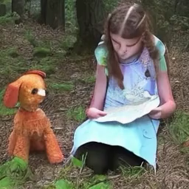
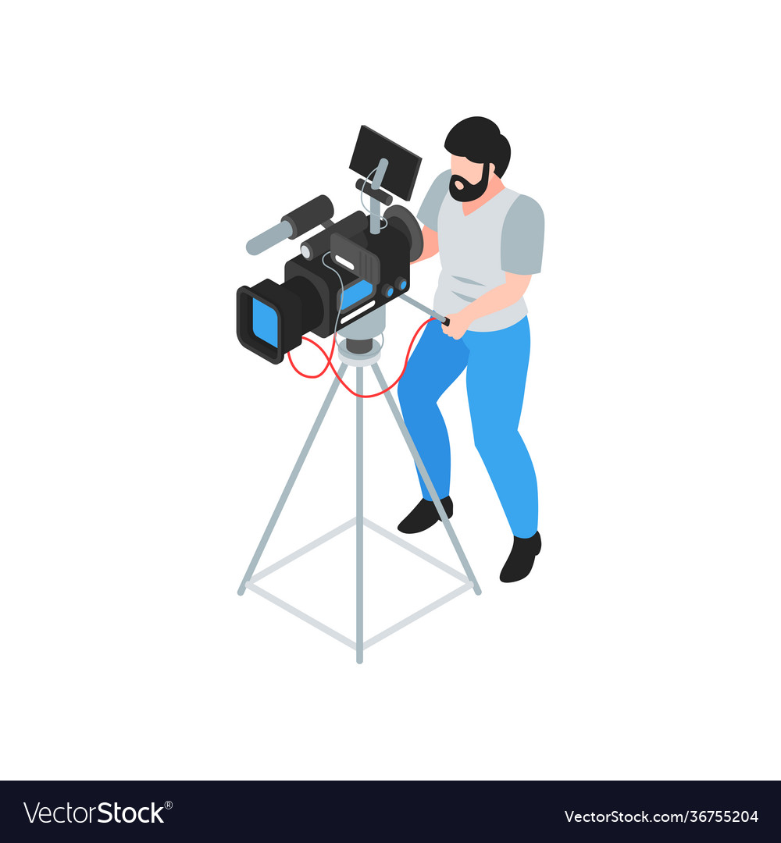
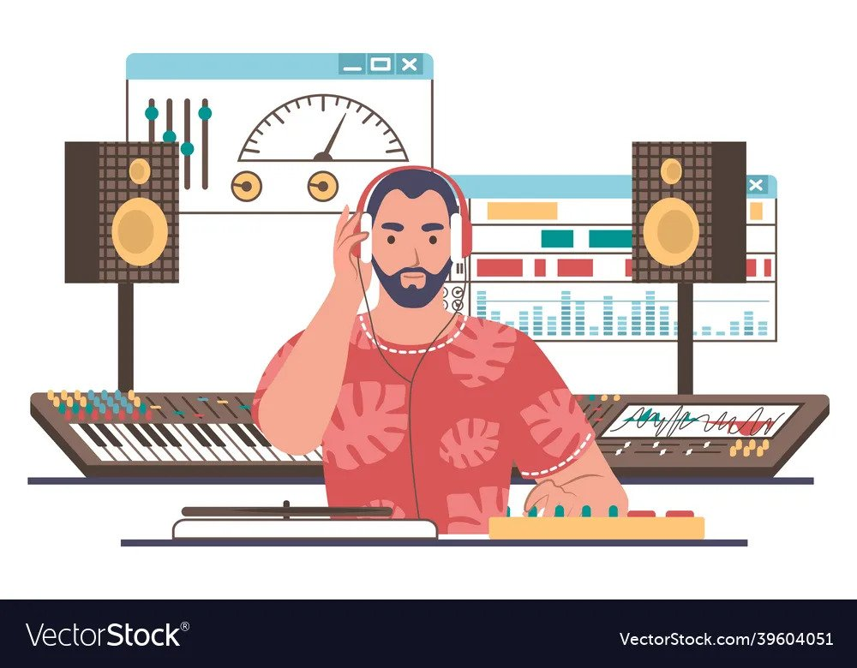
AI Content Creation Challenges
Technical Challenges

Slide 3




The Synchronization Problem
Explaining the Problem Statement
Generated Audio & Video - Out of Sync

Slide 4
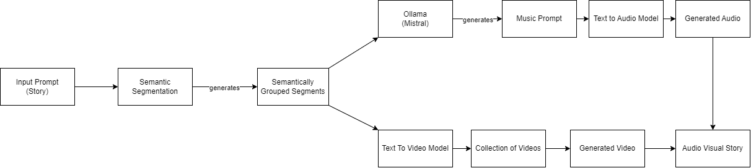
Current Implementation Overview

Slide 5
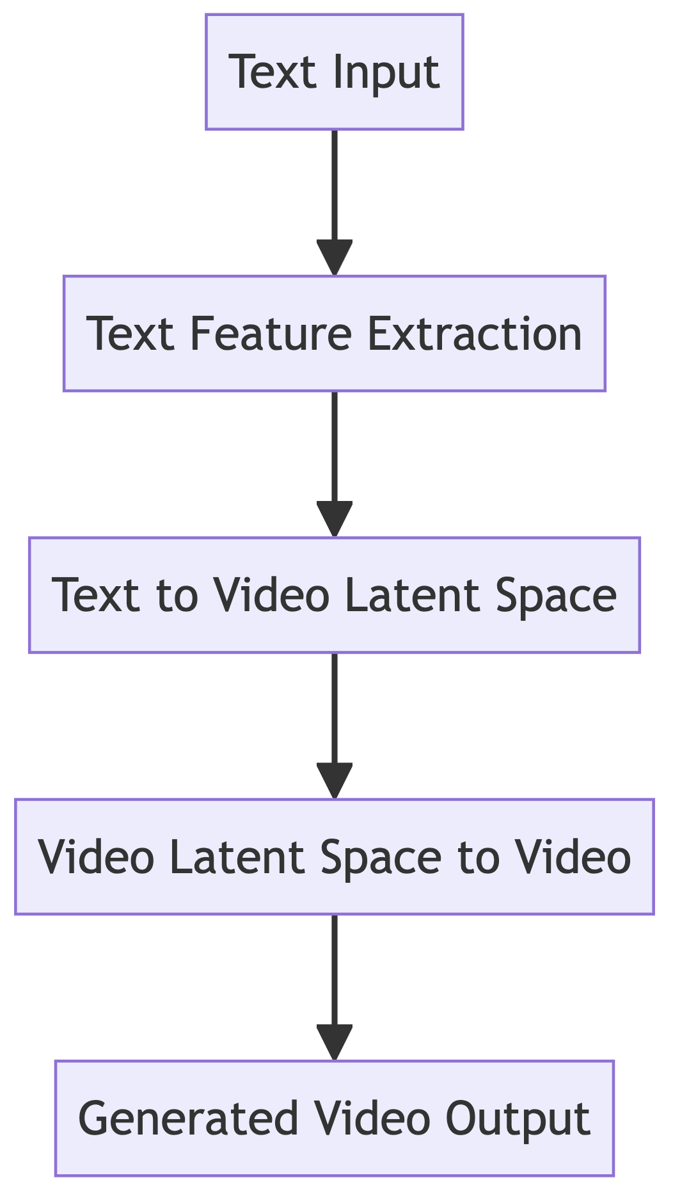
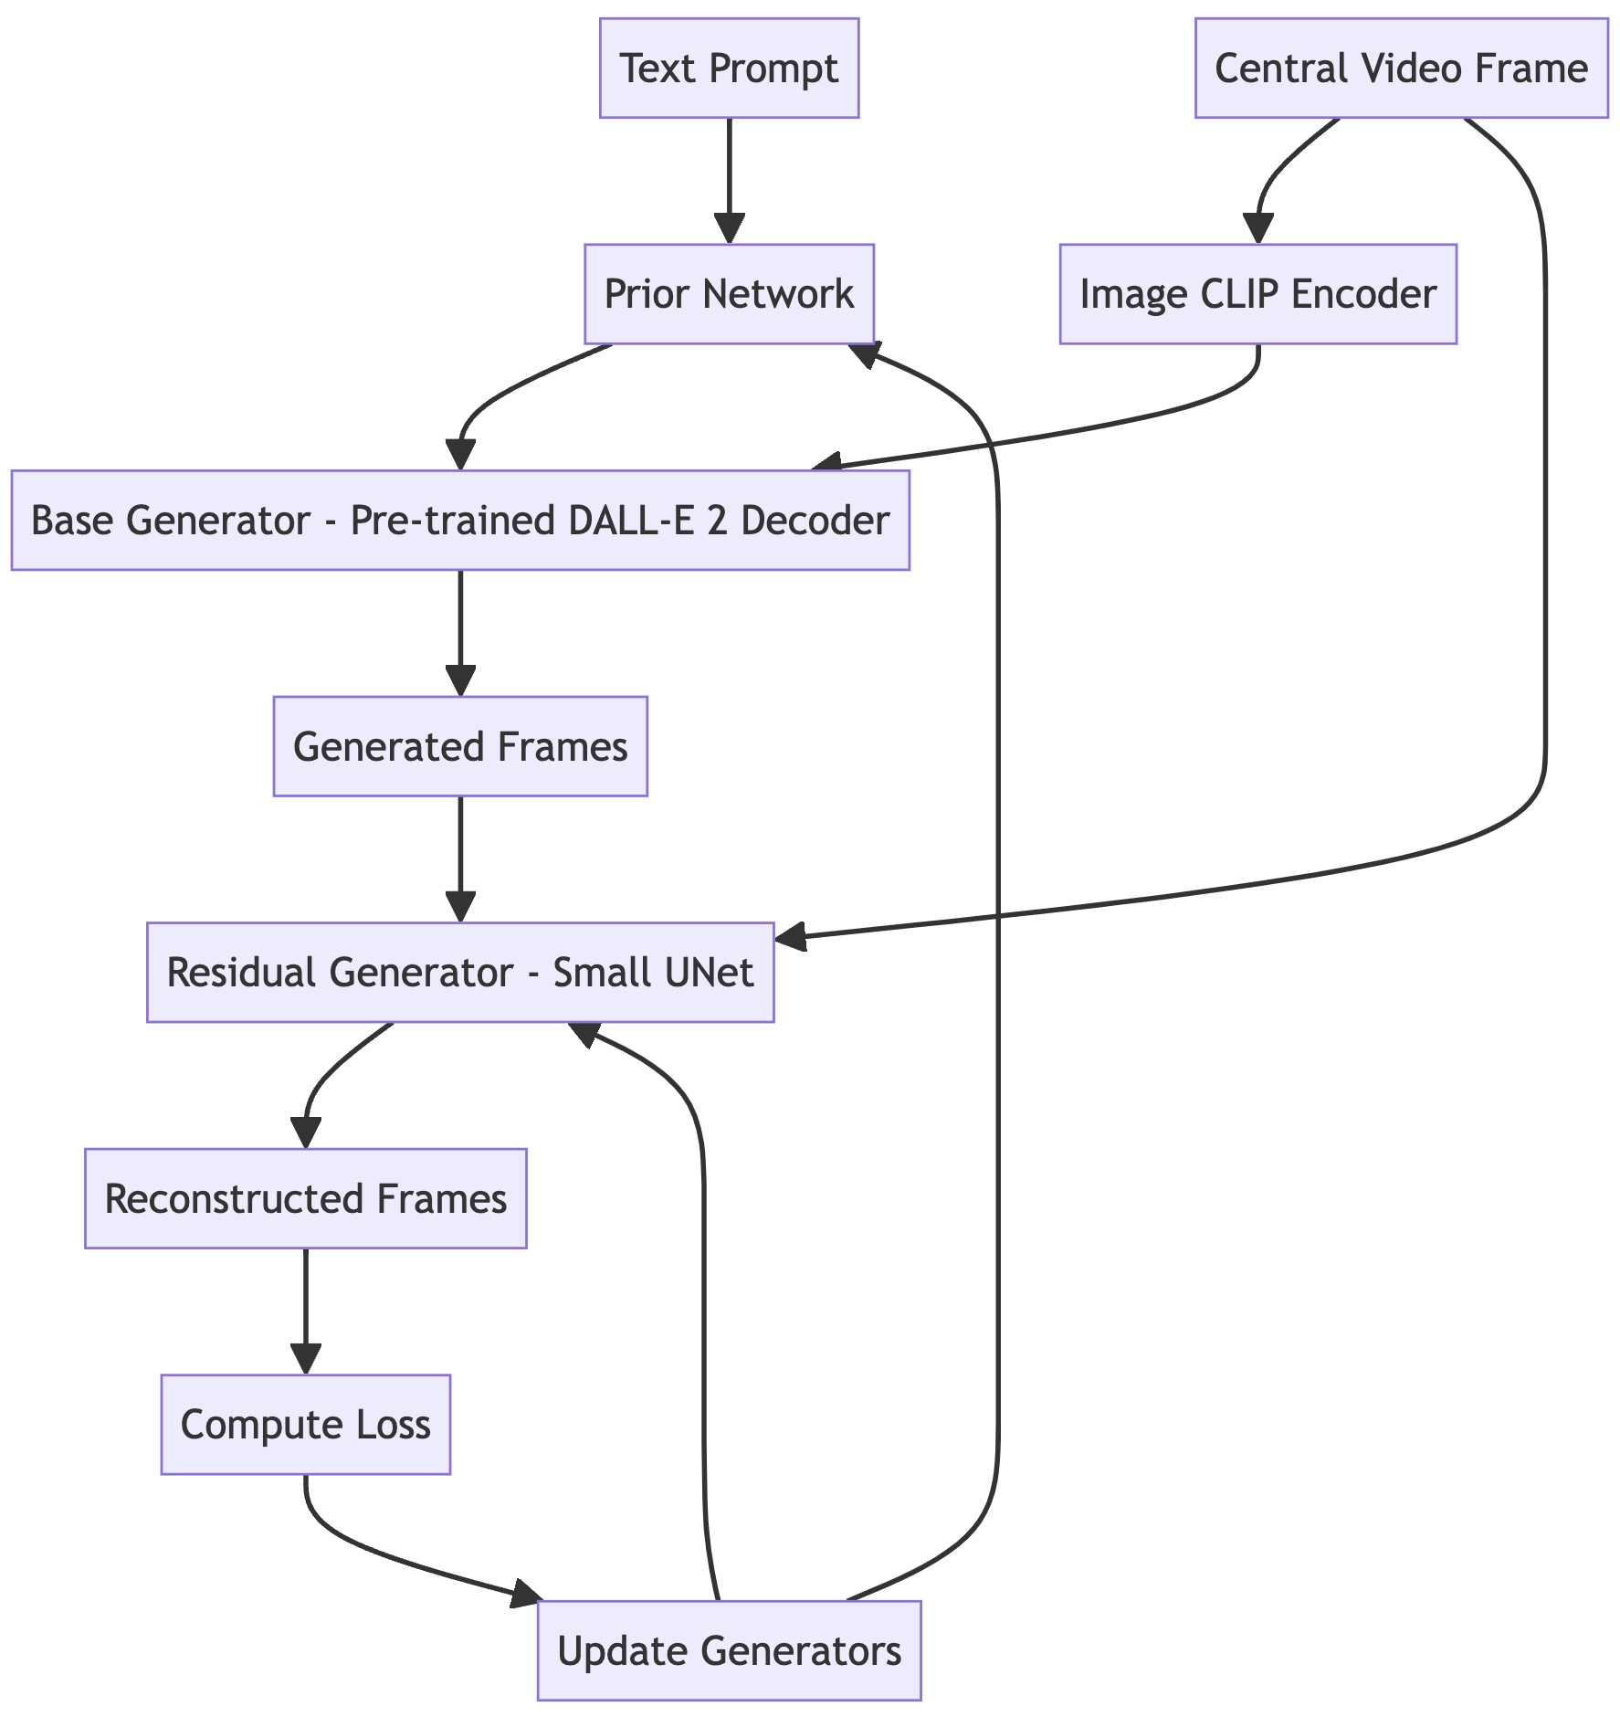
Text2Video - damo-vilab/text-to-video-ms-1.7b
Text2Video - High Level Overview
Training Loop - VideoFusion
Training Data - LAION5B, ImageNet, Webvid and other public datasets

Slide 6
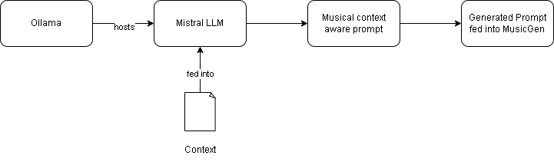
Generating Musical Context

Slide 7
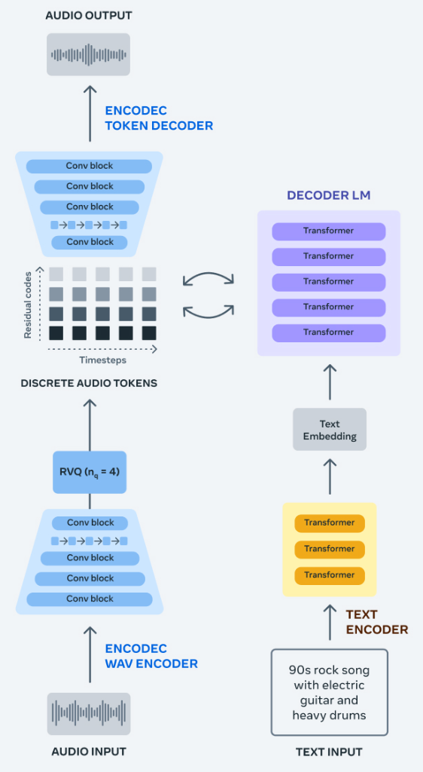
Text2Music - MusicGen: Simple and Controllable Music Generation
Training Data - 20K hours of licensed music spanned across 10K high-quality music tracks, ShutterStock and Pond5 music data.
Evaluation Data - Music Caps Benchmark composed of 5.5K samples (ten-second long) prepared by expert musicians and a 1K subset balanced across genres.

Slide 8
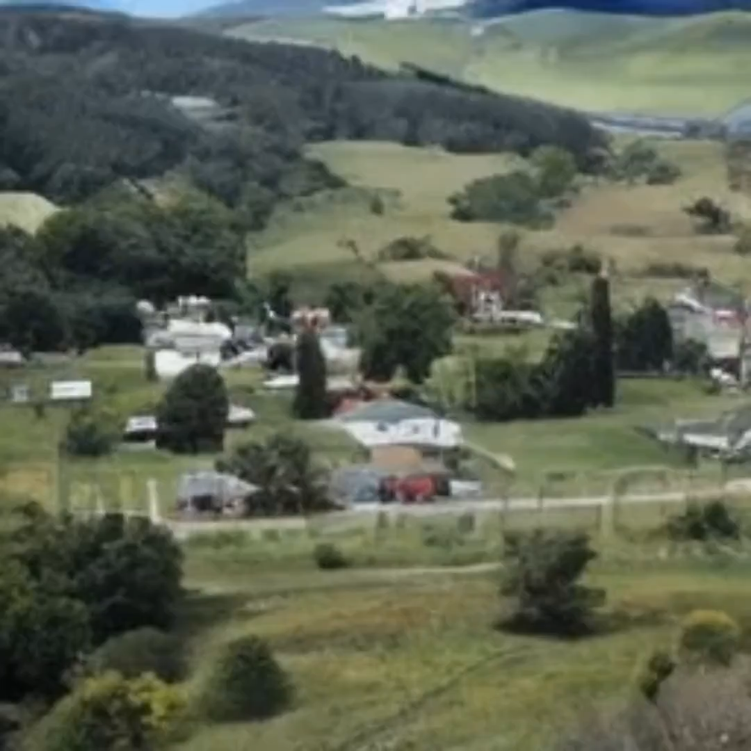
Demo
Story Prompt: In a small town nestled between rolling hills, lived a young girl named Lily. She had a curious pet named Sparky. One day, while exploring the woods behind her house, Lily stumbled upon a mysterious old map. The map seemed to lead to a hidden treasure. With Sparky by her side, Lily embarked on an adventure, facing challenges and overcoming obstacles along the way, until finally reaching a hidden cave. There, the long-lost treasure awaited their discovery. As they uncovered the treasure, a surprise awaited them—it held a secret that would change Lily's life forever.

Slide 9
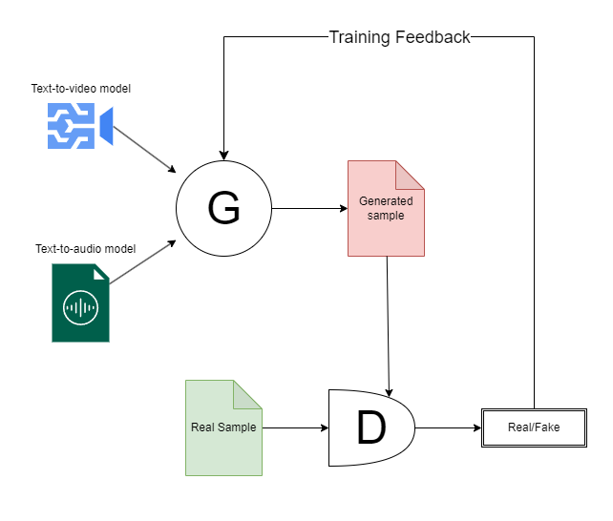
Next step: Generative Adversarial Networks
Problems to solve:
Deterministic timing
Incompatibility of semantically segmented prompts.
GAN approach: Train existing AV samples vs generated samples to achieve better synchronization.

Slide 10
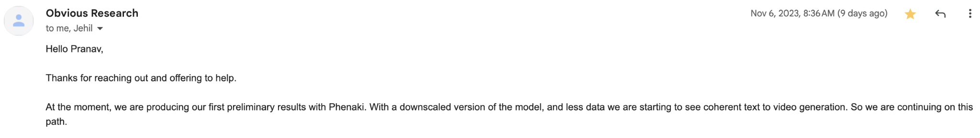
Conclusion
Setting up surveys to collect feedback on the generated results.
Phenaki released in February 2023. Contributing to its open source implementation with “Obvious Research”.

Slide 11
Questions?

Slide 12
Thank You!

